Slide 1




.
CMPSC 360 – Discrete Mathematics for Computer Science
Dr. Adriano Cavalcanti
PhD MABE, MS EE, BSc CSc
Computational Nanotechnology & Biomed Robotics
Office location: Burke 165 - Phone 814-898-6688
Email: axc525@psu.edu / cavalcanti@psu.edu
Office hours:
Tuesday 10AM-12PM & Wednesday 3PM-4PM or by appointment

Slide 2












Given Demonstrate the Power Set for
P(A) = {7, 4, 5, 0, 9}

Slide 3
2. Check if the expression :
a) is a tautology, a contradiction, or a contingency
b) Make the Truth table for this set
c) Make the Venn diagram representation
d) Make the logic circuit gate representation for your solution
e) Make the code representation for the circuit gate
˥(P ↔ Q) ꓥ R ↔ ˥ R ꓦ((P ꓦ Q) ꓦ (P ꓥ Q)

Slide 4
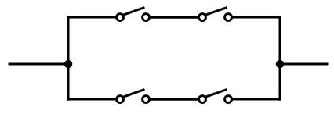

3. Simplify the logic circuit gate:
A
C
B
C

Slide 5
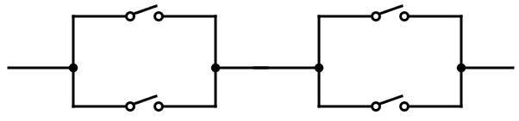
4. Simplify the logic circuit gate:
A
B
˥A
C

